Slide 1
BTT Recorder v1.4
Starting a new project

Slide 2
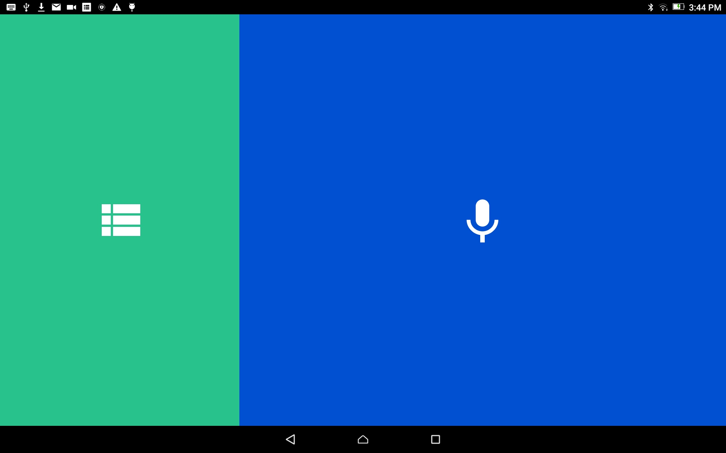
Start a Project:
From the home screen, tap in the green area to open the Project Manager.

Slide 3
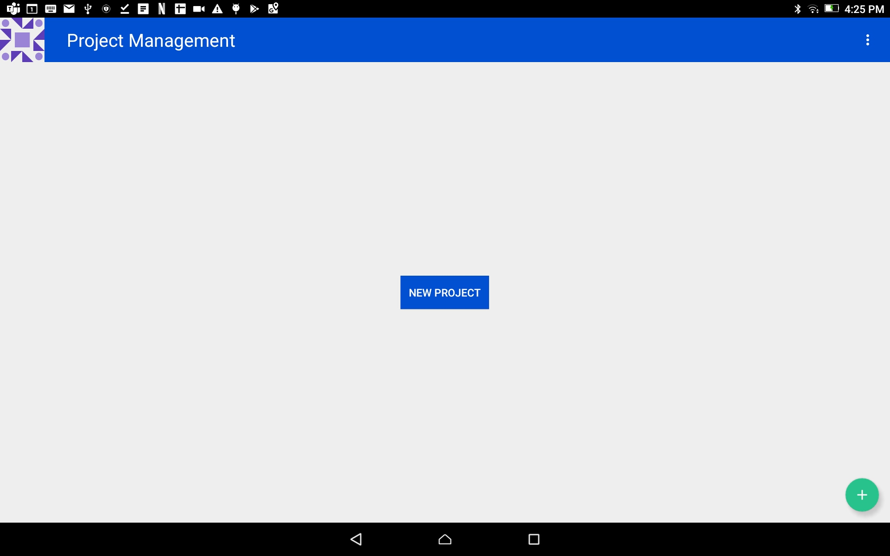
Start a Project:
Create a new project:
Tap on the ‘NEW PROJECT’ blue button.

Slide 4
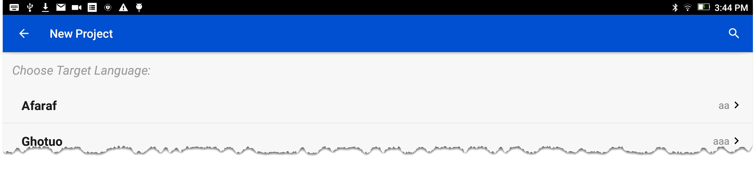
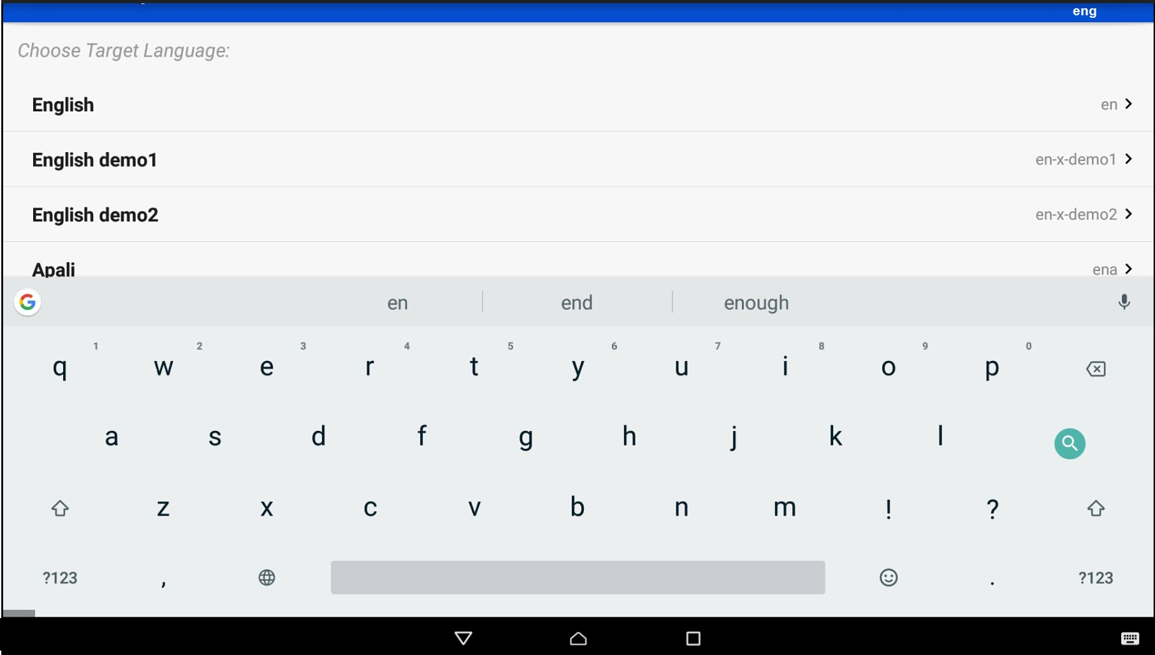


Start a Project
Select the Target Language:
The Target Language is the language into which you will translate.
Search for the desired language by either:
Scrolling to the language name.
OR
Clicking the magnifying glass and typing in the language name or language code.

Slide 5
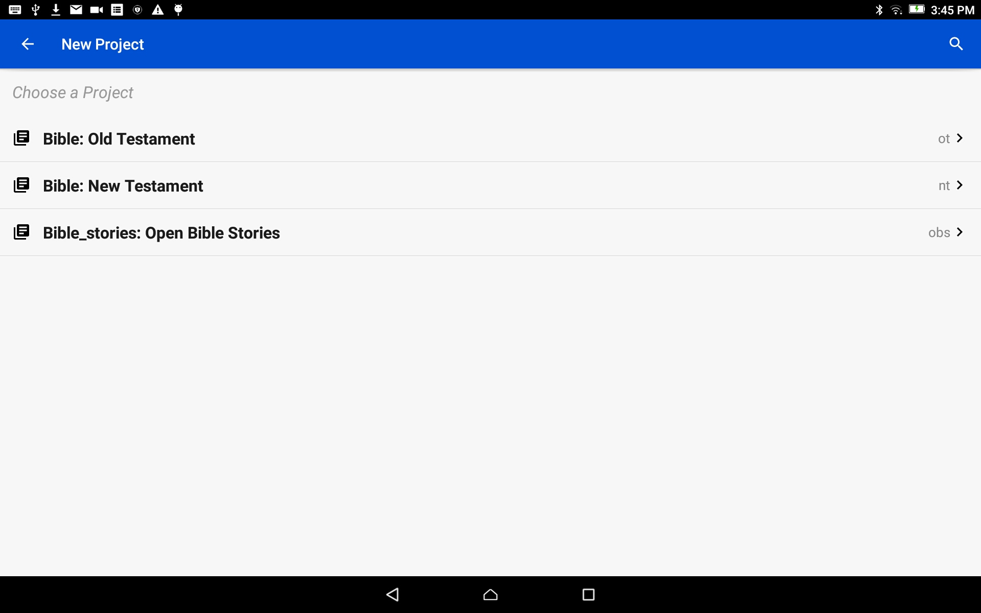
Start a Project
Choose a Project:
Tap on the words to choose to start an Old Testament, New Testament or Open Bible Stories project.

Slide 6
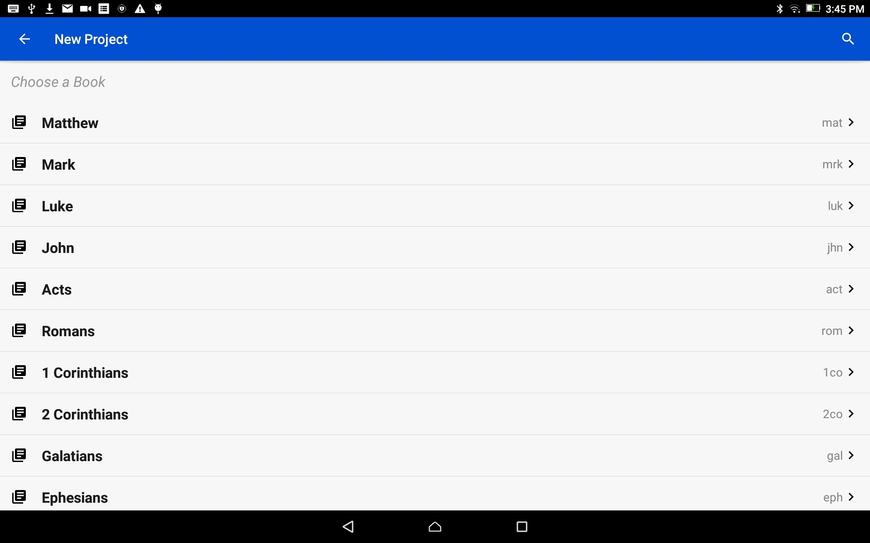
Start a Project
Choose a Book:
Tap on the book title to choose a book for the project.
Scroll down for more book names.

Slide 7
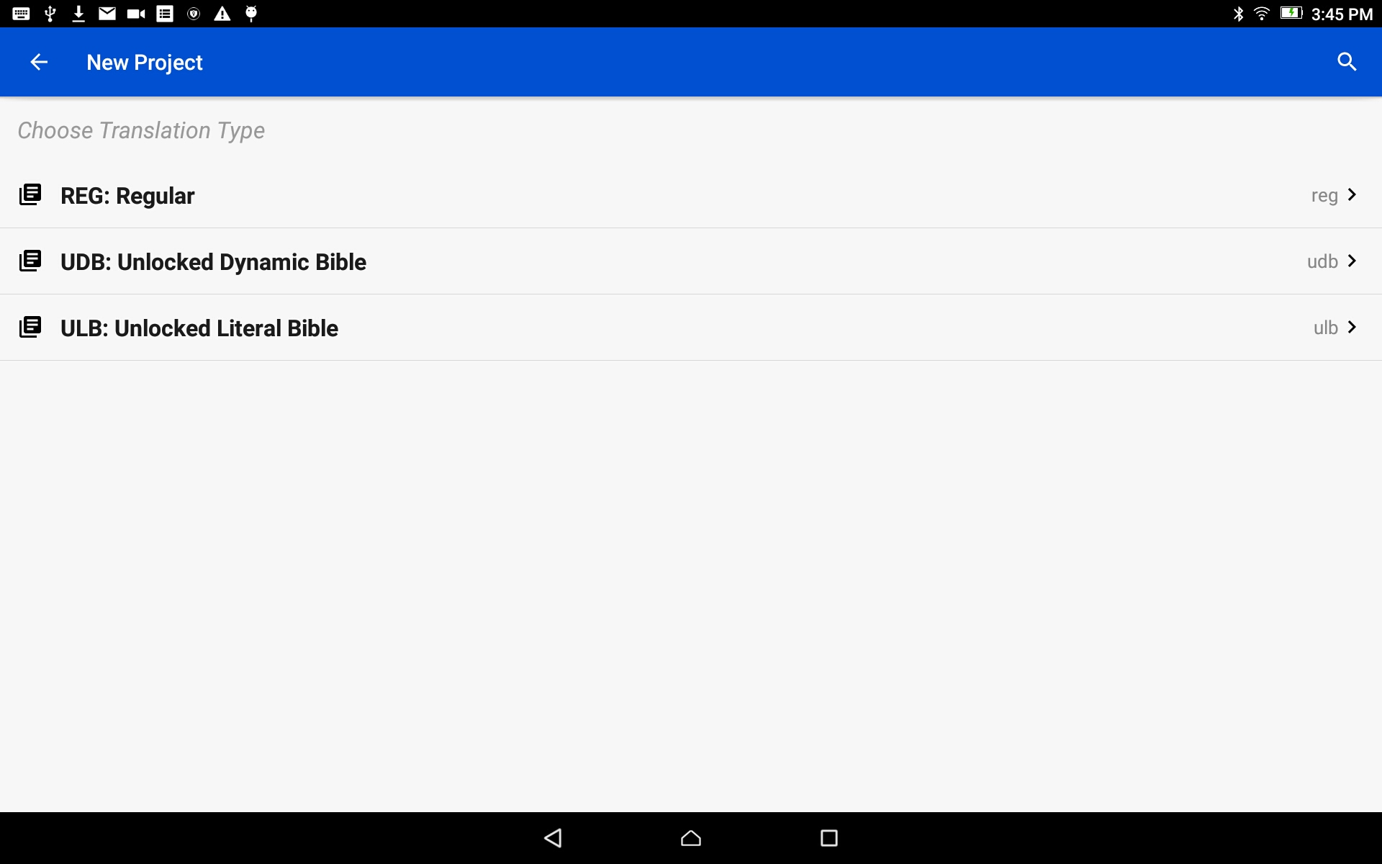
Start a Project
Choose a Translation Type:
The translation type is the type of translation of the final project work.
Tap on the words to choose a translation type.
Choose ULB if you will be importing English source audio.

Slide 8
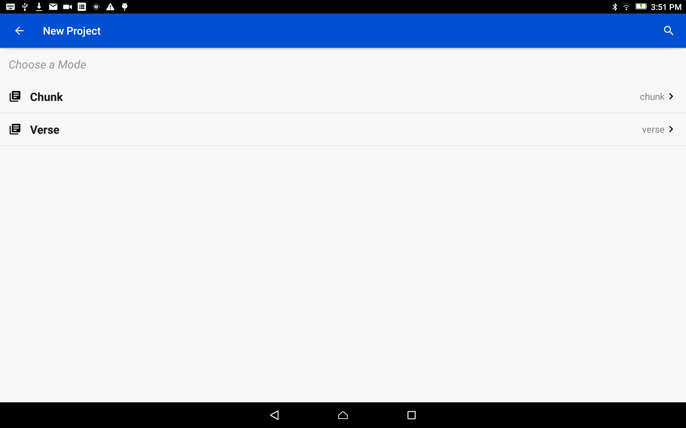
Start a Project
Choose a Mode:
Tap to choose either Verse or Chunk mode. This is how the information will be divided.
Choose Verse if you will be importing English source audio.

Slide 9
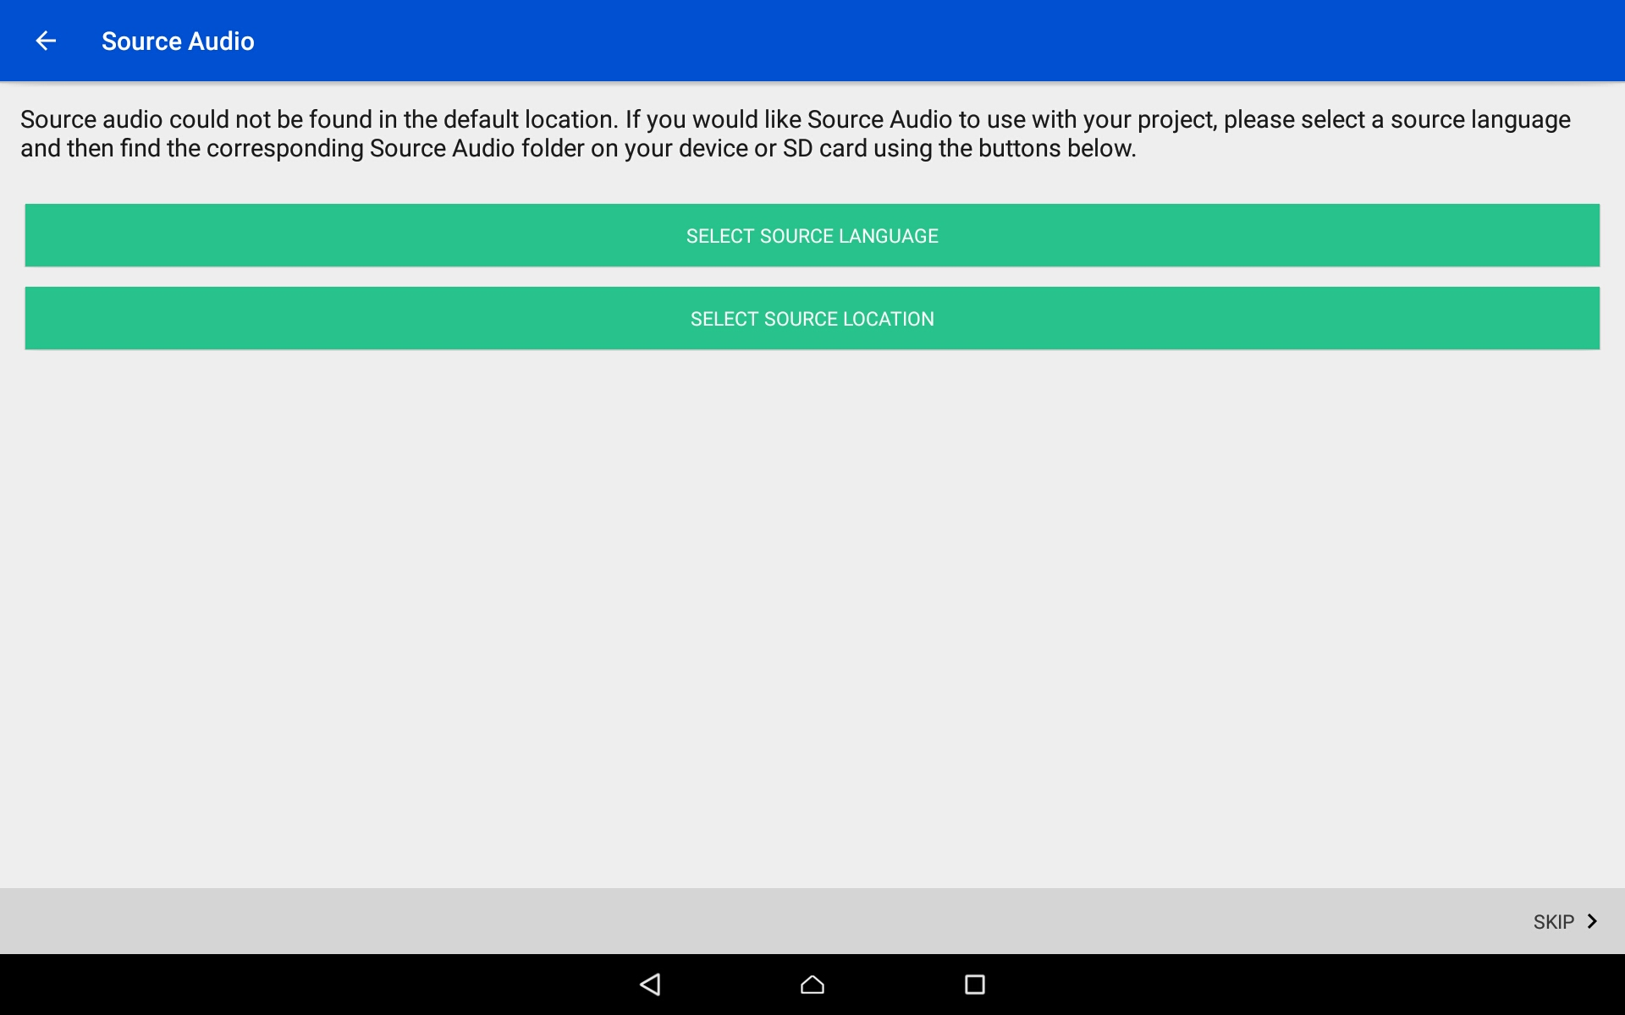
Start a Project
Skip this step if not using a source audio
Source Audio Selection:
The Source Language is the language from which you will translate.
Tap on the top green bar (Select Source Language).
Click here to skip the steps for source audio
Notes:
If not using source audio skip to slide 14

Slide 10
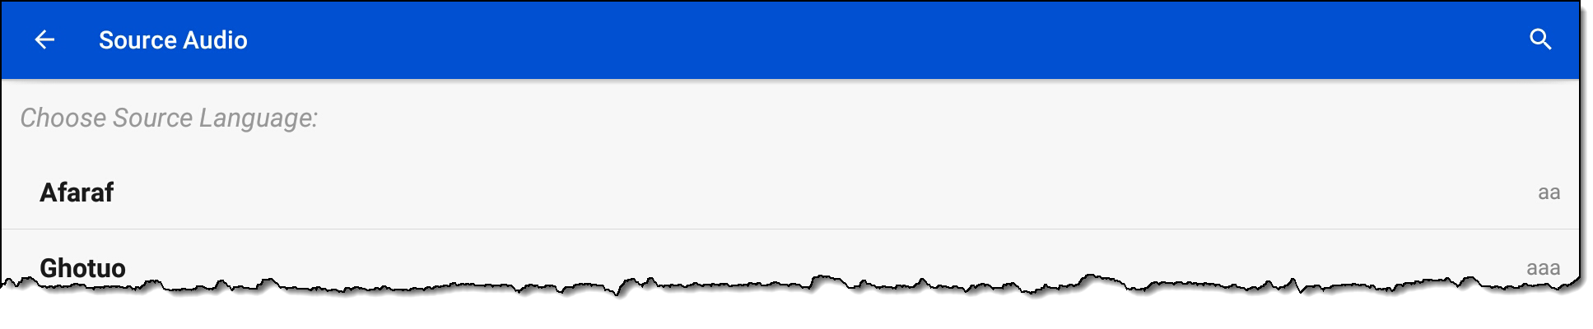
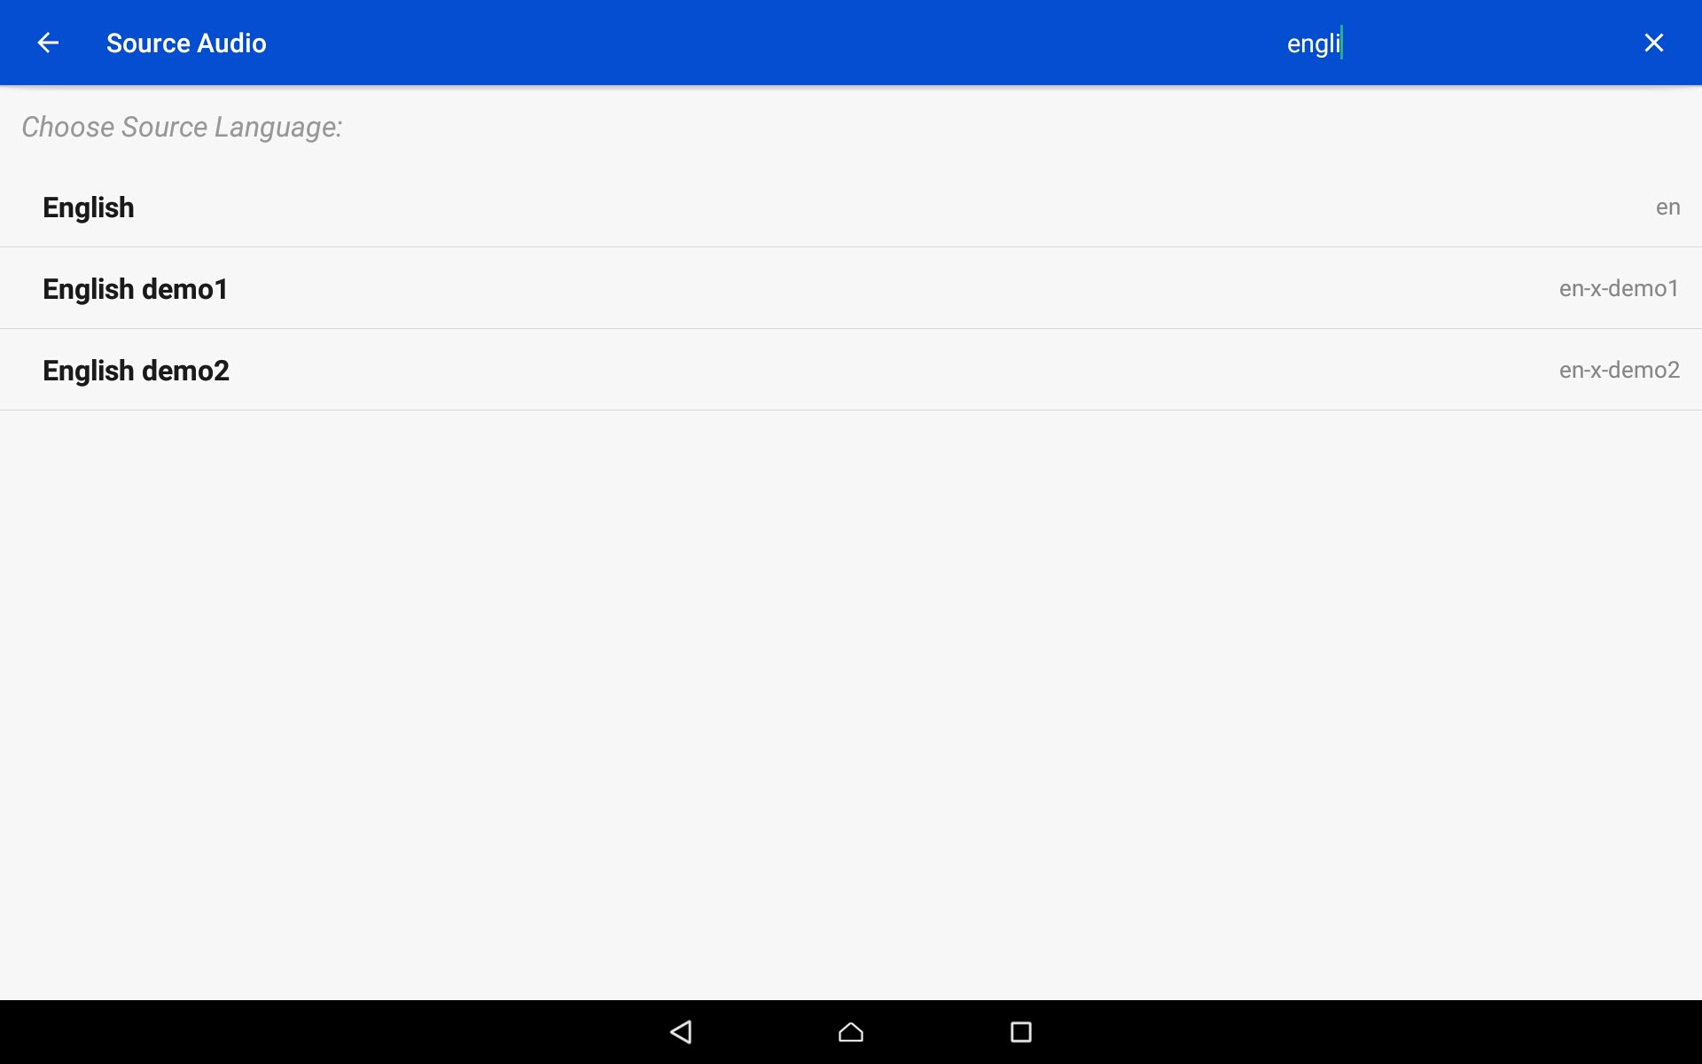
Start a Project
Skip this step if not using a source audio
Source Audio Selection:
Search for the desired language by either:
Scrolling to the language name.
Clicking the magnifying glass and typing in the language name or language code.

Slide 11
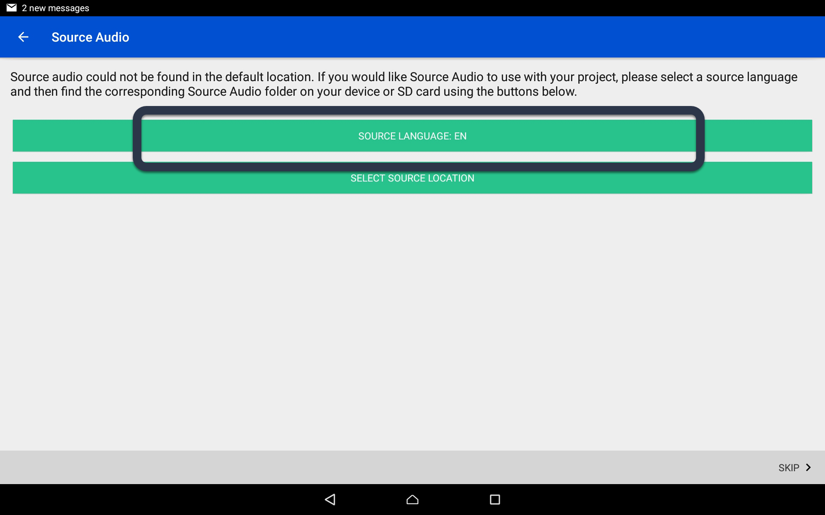
Start a Project
Skip this step if not using a source audio
Source Audio Selection:
The language code now shows on the Source Language green bar.
Tap on the bottom green bar (Select Source Location).

Slide 12
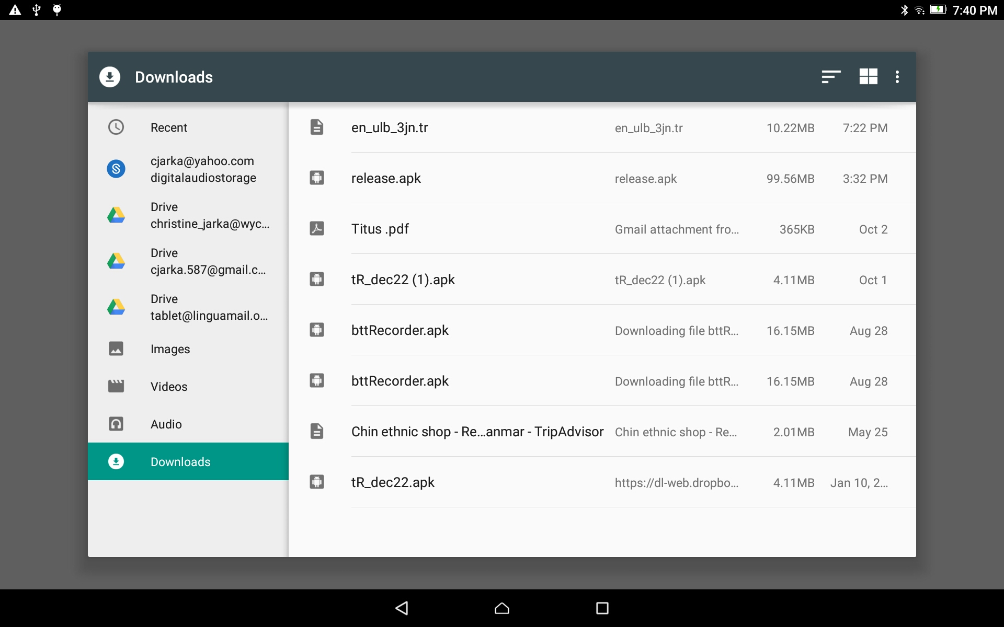
Start a Project
Skip this step if not using a source audio
Source Audio Selection:
Use the File Manager to find and select the appropriate source file.
(The facilitator will help with this.)

Slide 13
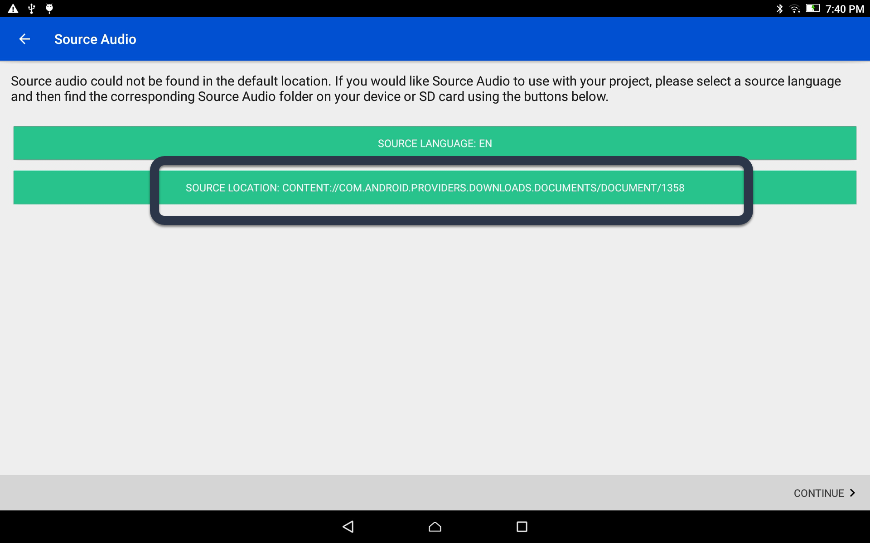
Start a Project
Skip this step if not using a source audio
Source Audio Selection:
The source language file name now shows on the Source Location green bar.
Close the keyboard.

Slide 14
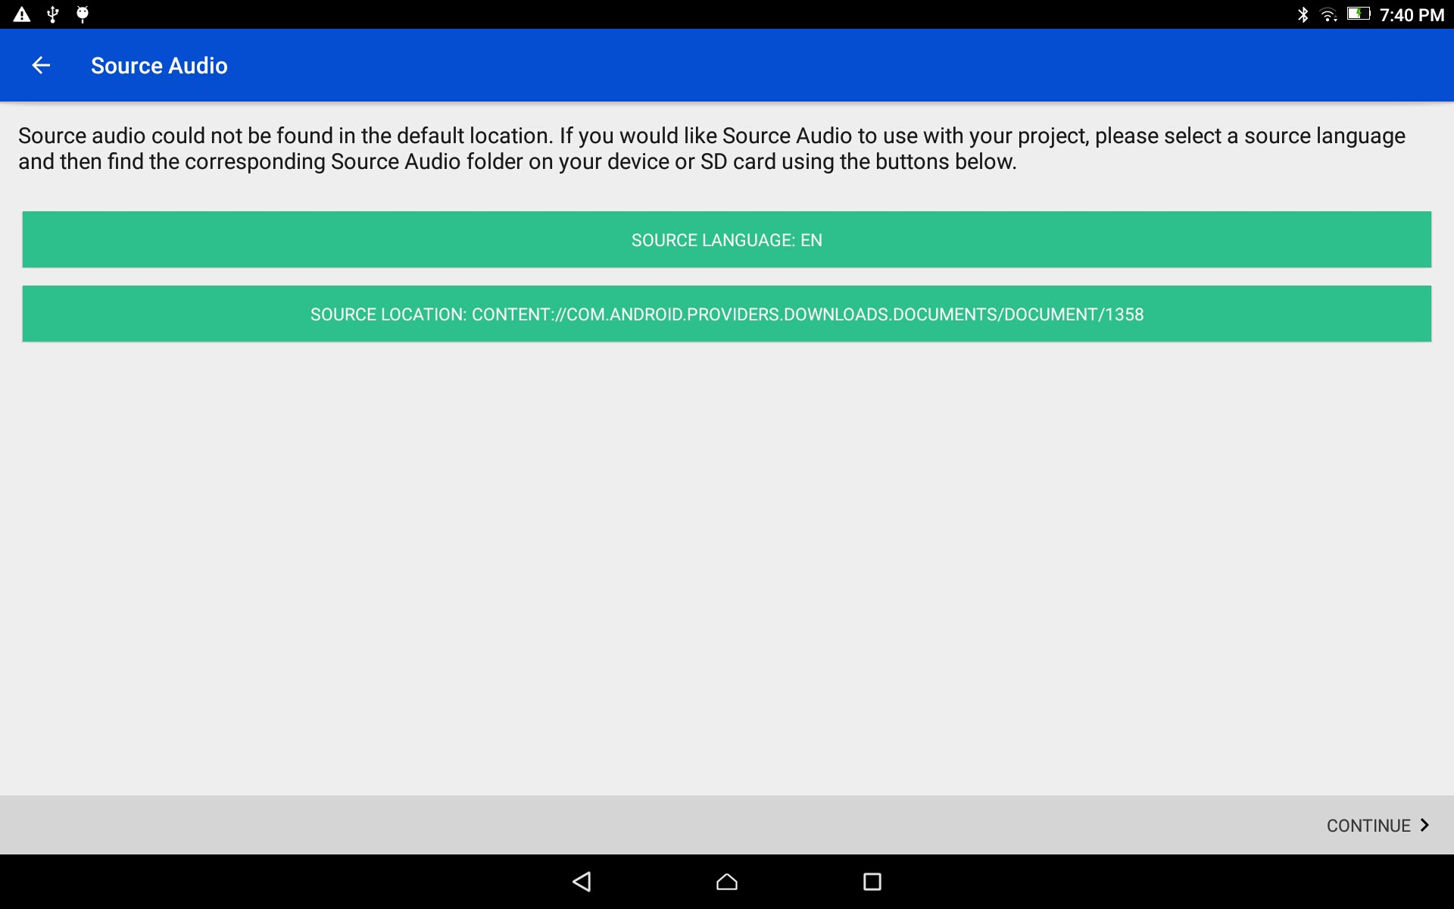
Start a Project
Skip this step if not using a source audio
Source Audio Selection:
Tap on the CONTINUE link at the bottom right.
Notes:
Do not use navigation icons on this slide. Click anywhere on the screen.

Slide 15
Start a Project
Source Audio Selection:
Skip this step if there is no source audio.

Slide 16
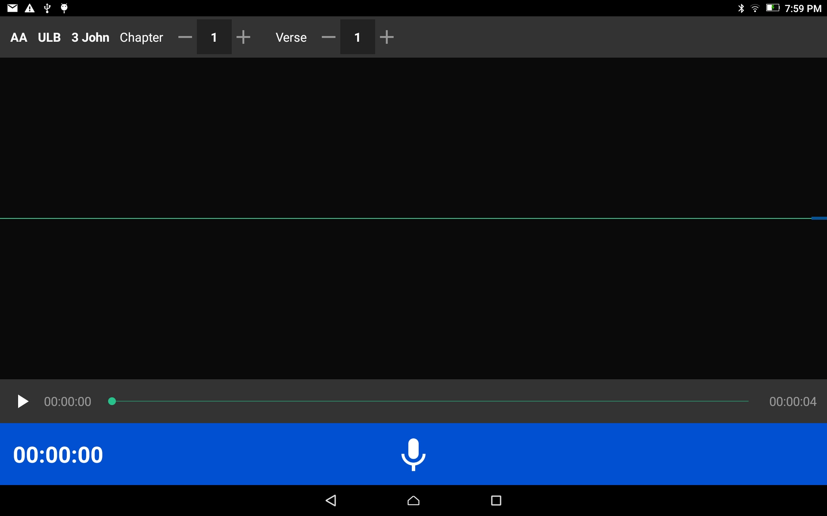
Start a Project
The new project starts

